Slide 1
Resolving galactic binaries in LISA data
using particle swarm optimization and cross-validation
Gravitational Wave Data Analysis School, China, 2021
Xuehao Zhang, Xiaobo Zou, Yuxiao Liu, Lanzhou University
Soumya D. Mohanty, The University of Texas Rio Grande Valley
Runqiu Lau, Institute of Applied Mathematics, AMSS, CAS

Slide 2
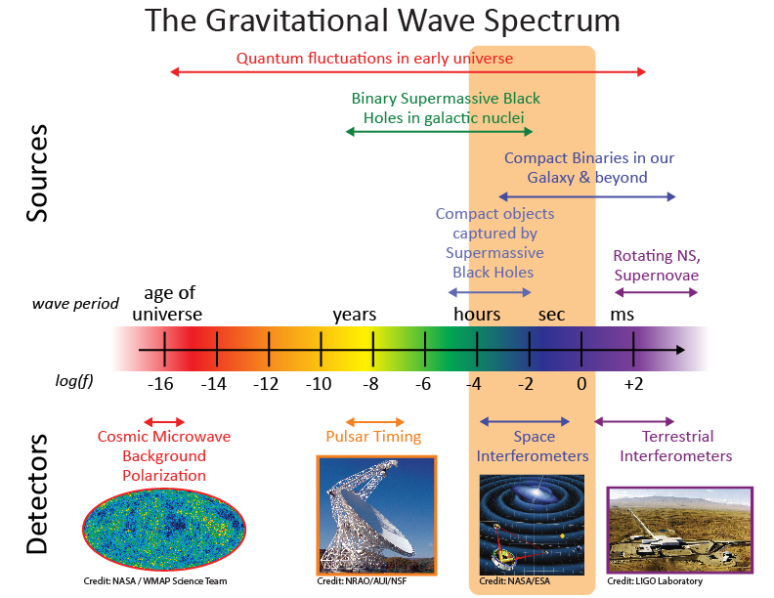
Gravitational wave spectrum https://lisa.nasa.gov/

Slide 3
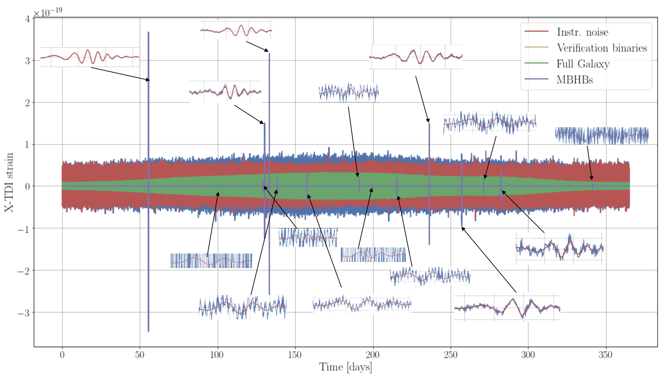
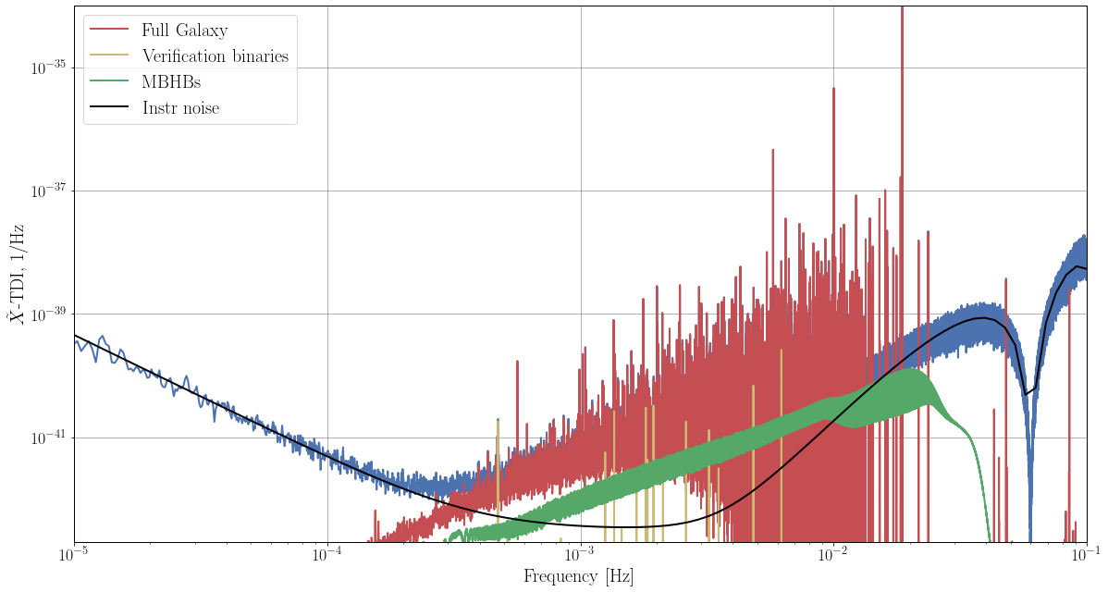
(Mock) LISA Data Challenge
2006 - 2010: MLDC1~4
https://asd.gsfc.nasa.gov/archive/astrogravs/docs/mldc/ (no longer updated)
2018 – 2021: LDC1 LDC2
https://lisa-ldc.lal.in2p3.fr/
Different components in LDC2. https://lisa-ldc.lal.in2p3.fr/challenge2
Time domain of LDC2 data, https://lisa-ldc.lal.in2p3.fr/challenge2

Slide 4
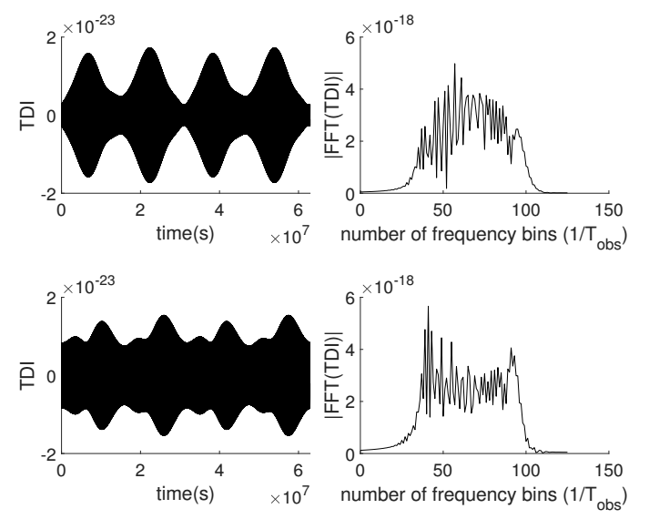
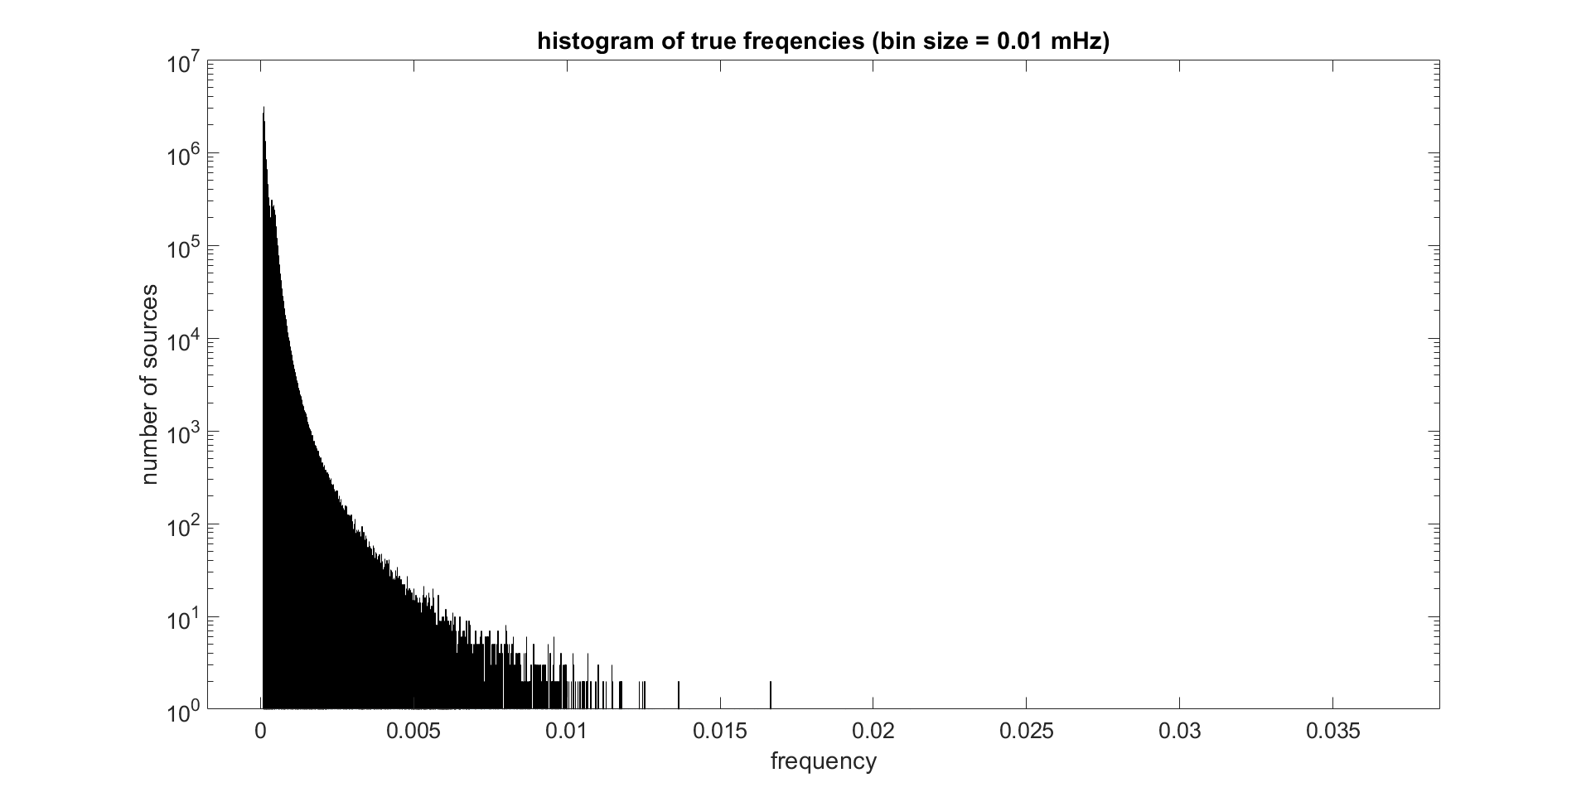
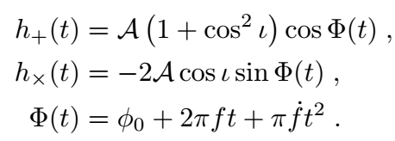
White dwarf binaries:
Simple waveform:
But huge population (10^7 in LISA band)

Slide 5
Methods: GBSIEVER
Galactic Binary Separation by Iterative Extraction and Validation using Extended Range
按 0.02 mHz 分频，相互交叠，消除边界效应；
在各频带，利用匹配滤波，采用粒子群算法（PSO）搜索单个波源；
扣除搜索到的波源；
重复2、3直到无法继续搜索出波源；
扩大参数搜索范围（频率导数），重复2-4，做交叉验证。
Iterative Extraction
Validation using Extended Range

Slide 6
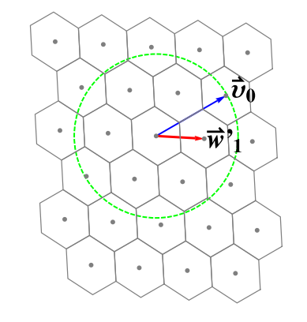
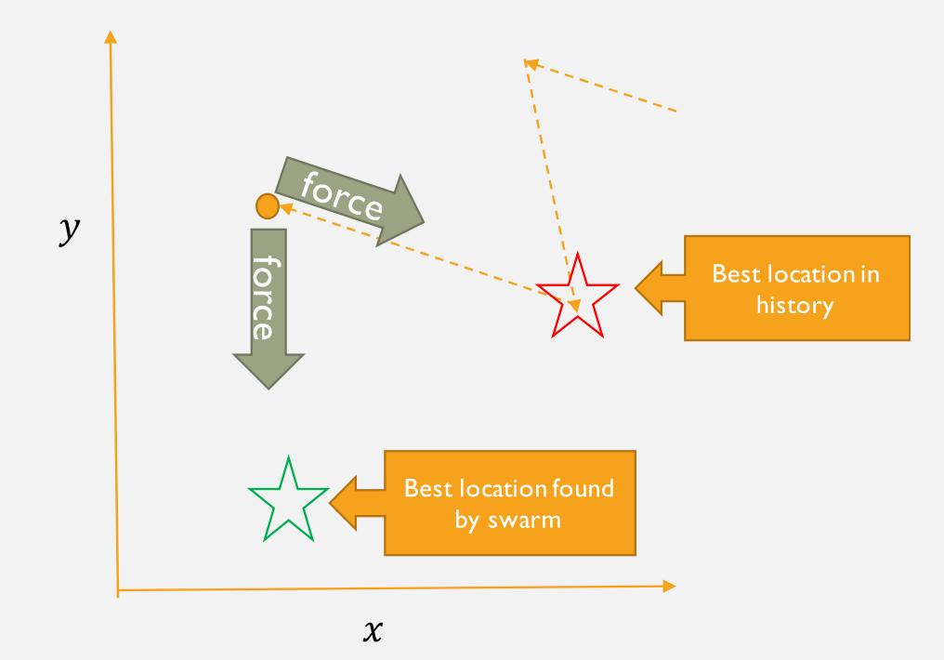
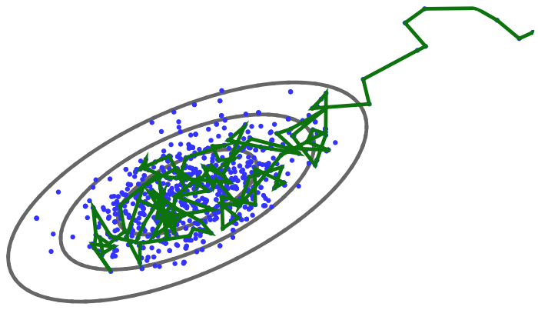
Global Optimization:
“Lattice”: grid-based search
GBSIEVER: Particle Swarm Optimization (PSO)
A. Blaut, S. Babak,
A. and A. Krolak, 2010.
BAM: MCMC
N. J. Cornish and
J. Crowder, 2007.
https://wiki.ubc.ca/Course:CPSC522/MCMC

Slide 7
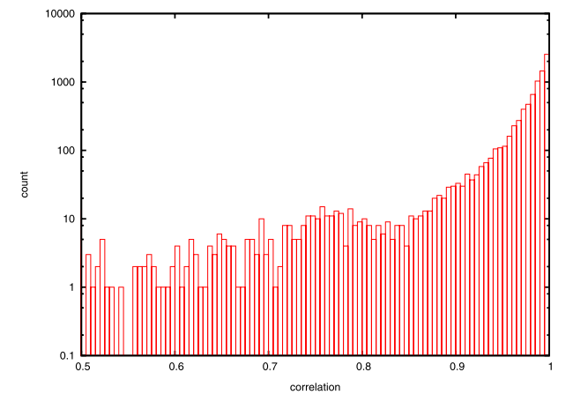
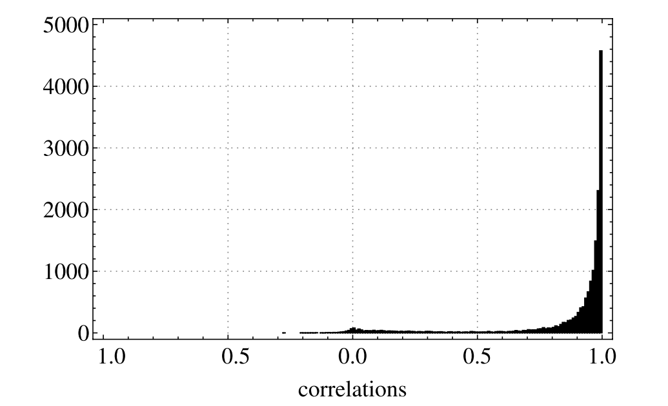
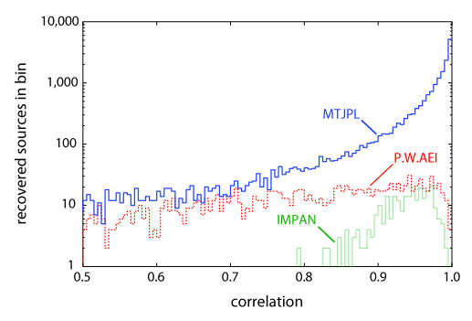
Current status:
BAM (by Crowder and Cornish, ~2007), ~20000 sources, 85% detection rate
Extended BAM (by Littenberg, 2010), ~9000, 90% detection rate
“Lattice” (by Blaut and Babak, 2020), ~12000, unknown detection rate

Slide 8
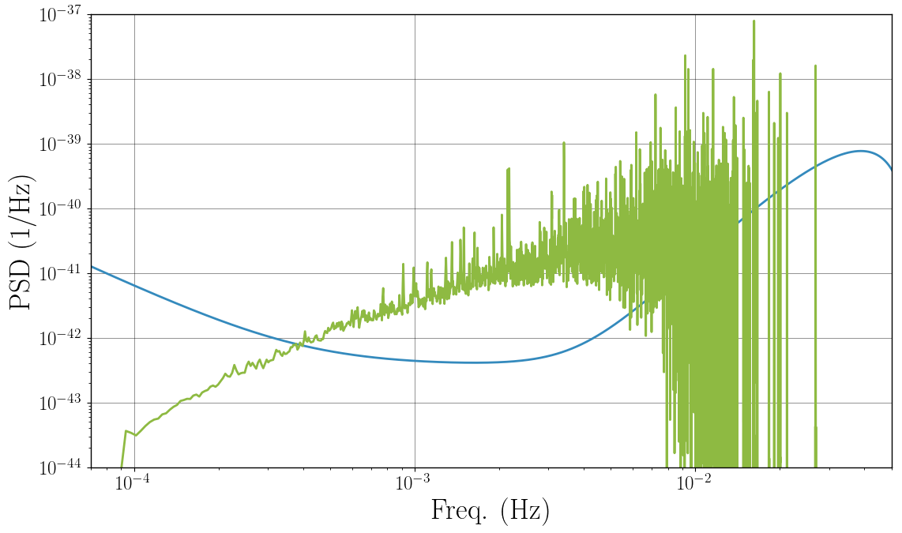
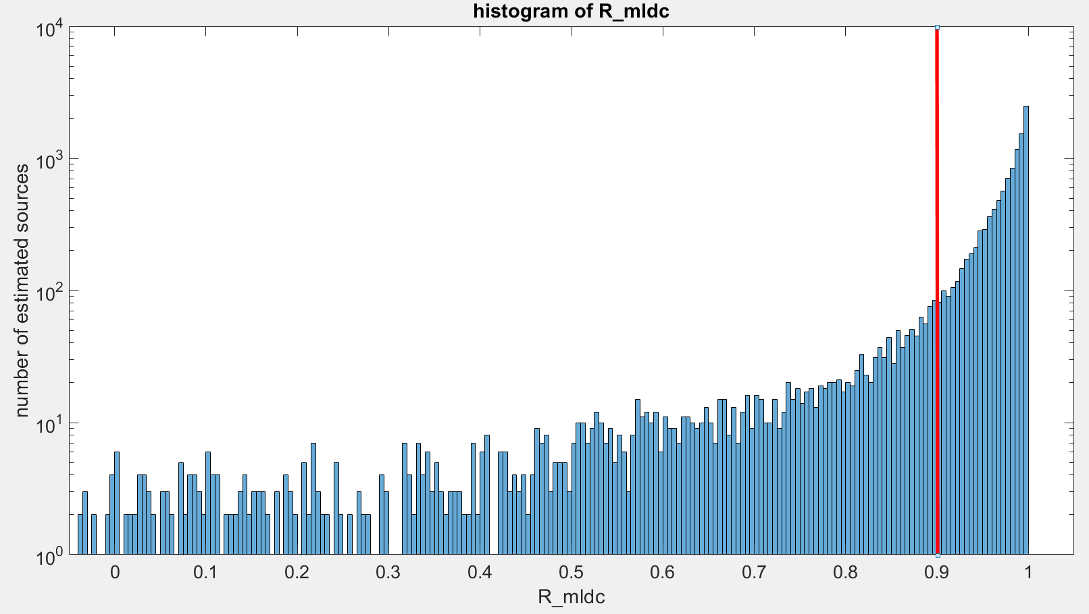
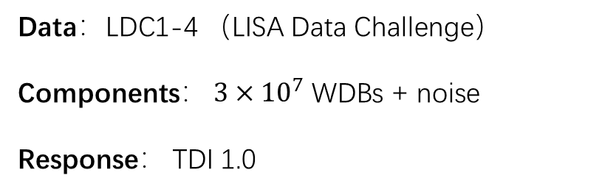
Results:
Confirmed sources
Data：LDC1-4 （LISA Data Challenge）
Components： $3×{10}^{7}$ WDBs + noise
Response： TDI 1.0
Reported sources
Detection rate：84.28% ~ 91.19%
Reported: 12270 ~ 9291
Confirmed: 10341 ~ 8472
https://lisa-ldc.lal.in2p3.fr/challenge1

Slide 9
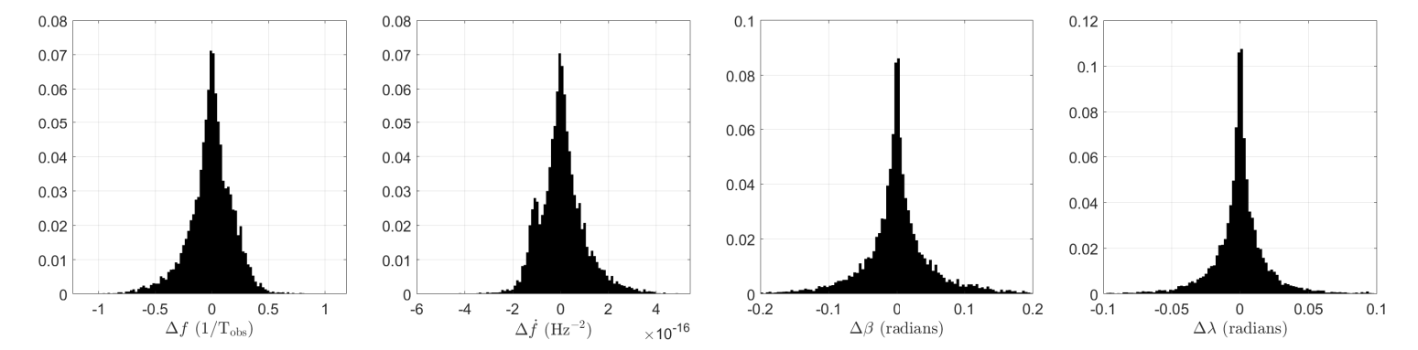
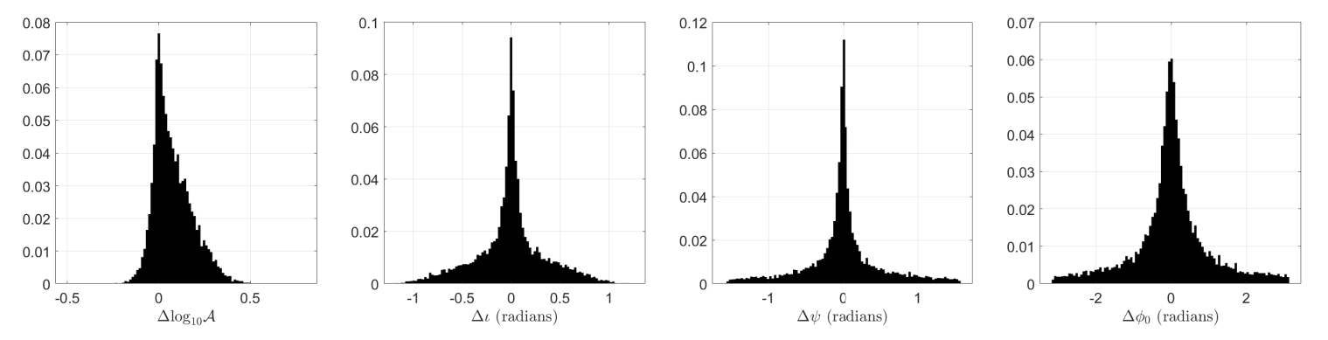

Slide 10
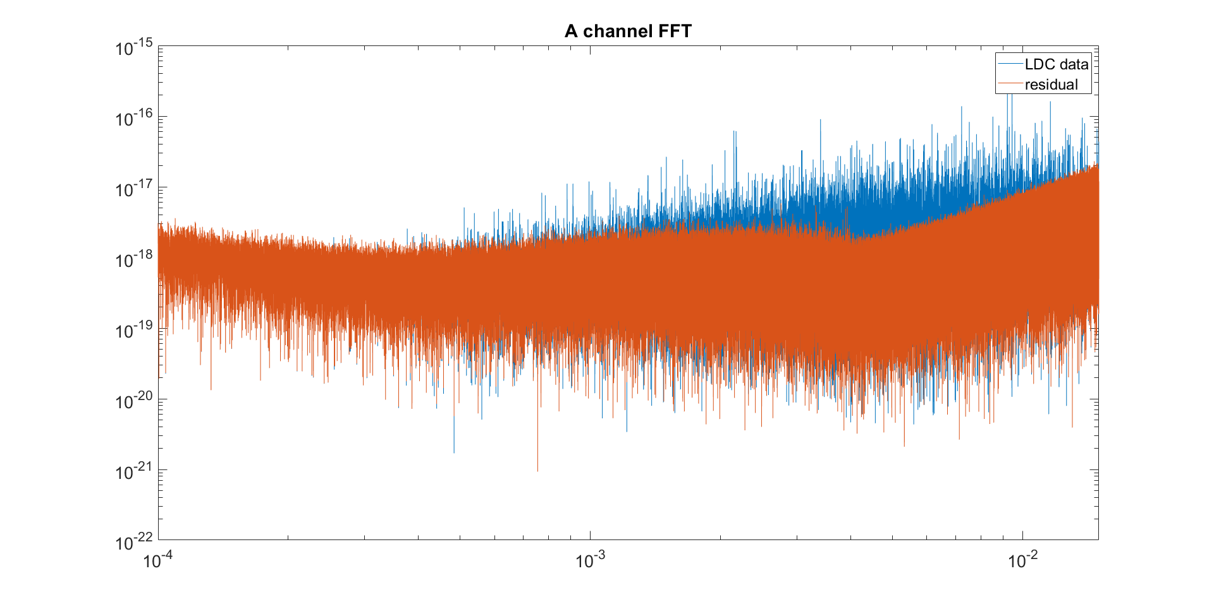

Slide 11
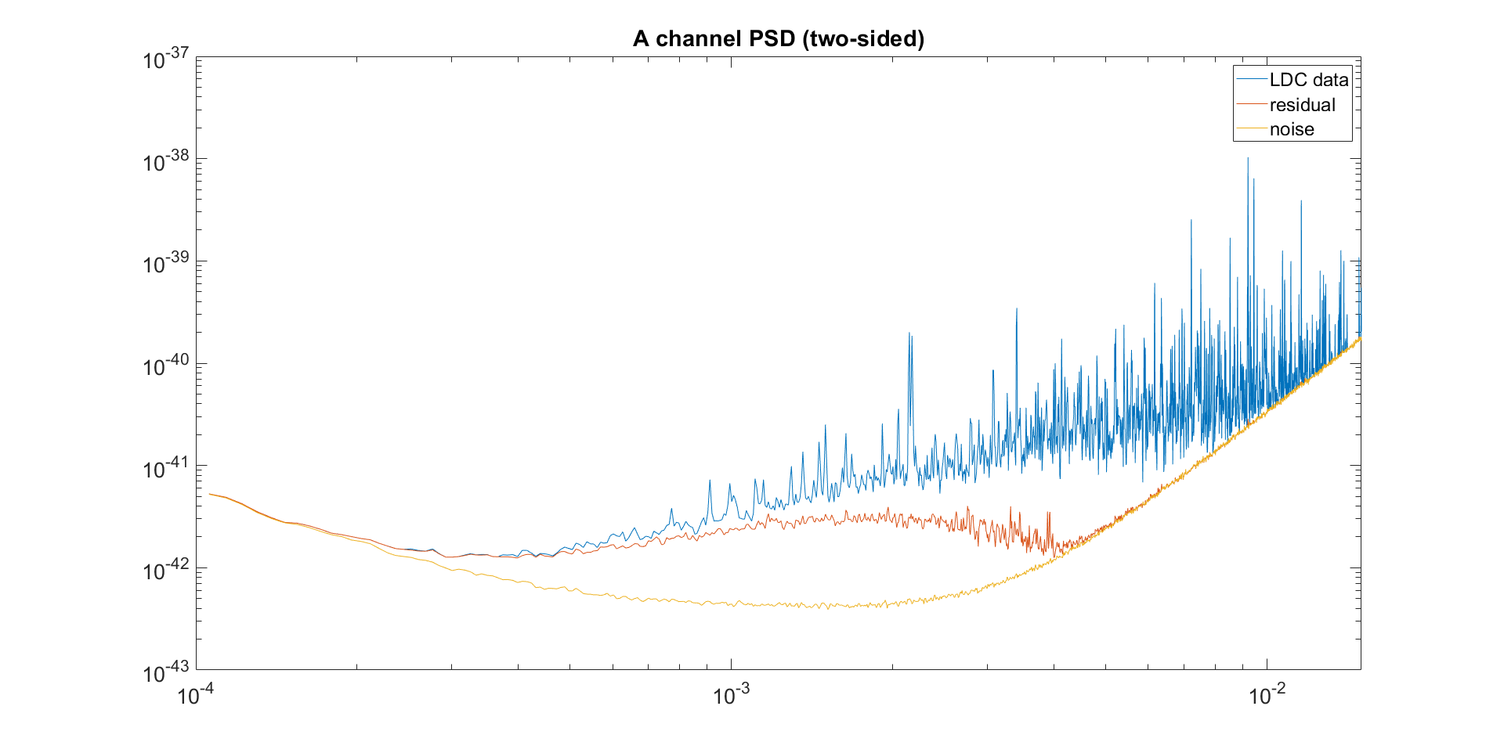
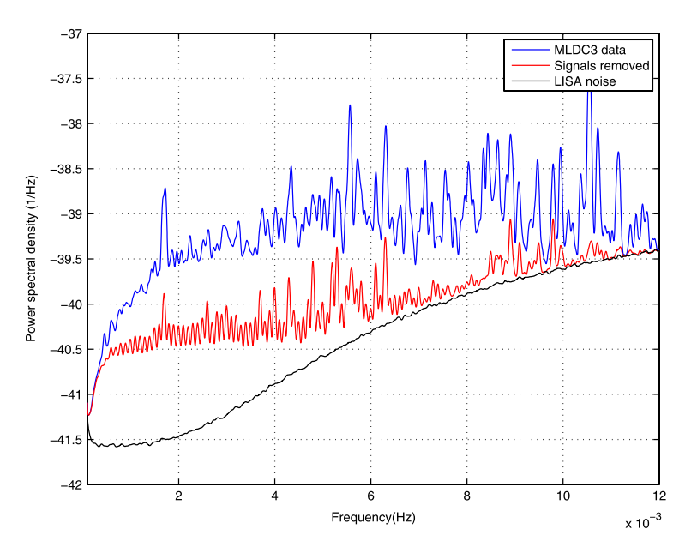
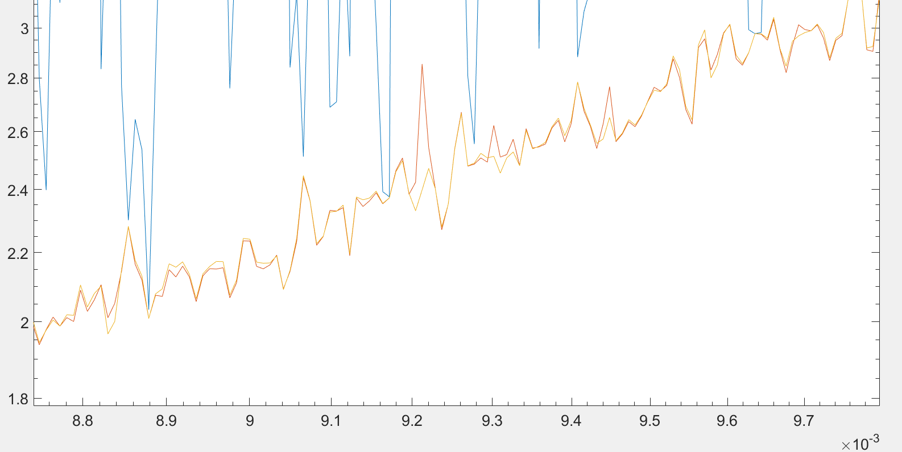
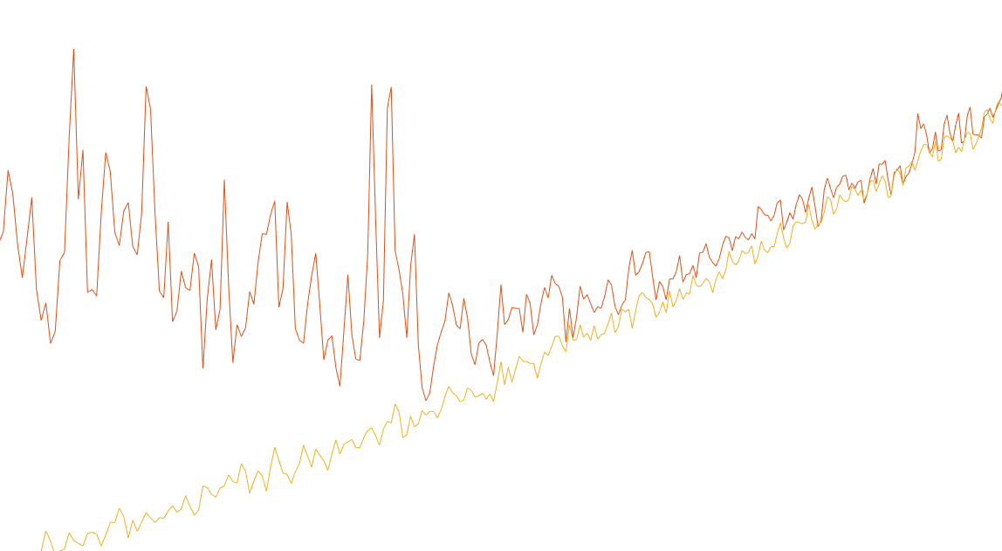

Slide 12
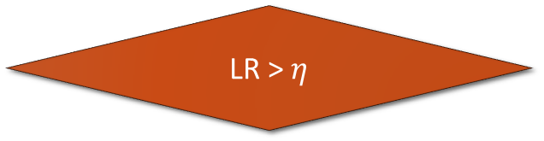
Data Stream (A, E, T channel)
New data in the frequency bin
Band passed filter
and downsample (undersample)
Subtract it from the data
Data in a narrow frequency bin
Optimize F-statistic using PSO
(i.e. maximize Likelihood Ratio)
Compute the signal corresponding to
the recovered parameters
LR > $η$
Yes
Save the recovered parameters (maximizers)
No
End
simplified flow chart

Slide 13
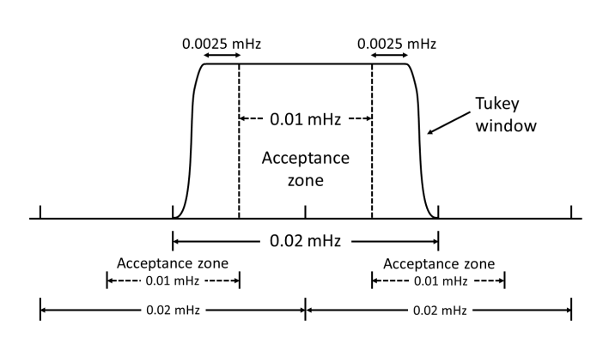
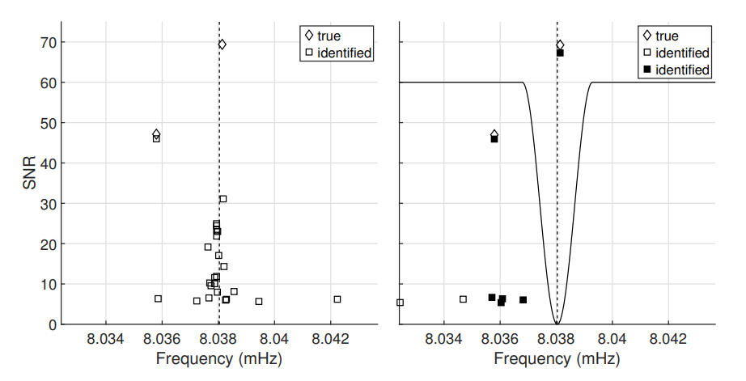
Band splitting and edge effects
Method adapted from: N. J. Cornish and J. Crowder, 2007.
Settings:
1. Equal band length: 0.02mHz
2. Adjacent bands overlap with each other, overlap: 0.01mHz
3. Acceptance zone: 0.01mHz, (reject all sources that are not in this zone)
4. Tukey window applied to data (to avoid repeating extracting spurious sources, see figure at the right.)
Method credit: N. J. Cornish and J. Crowder, 2007.

Slide 14
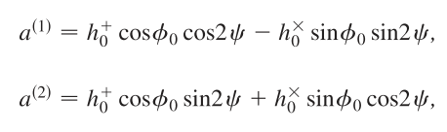
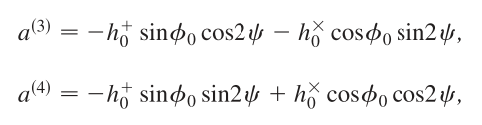
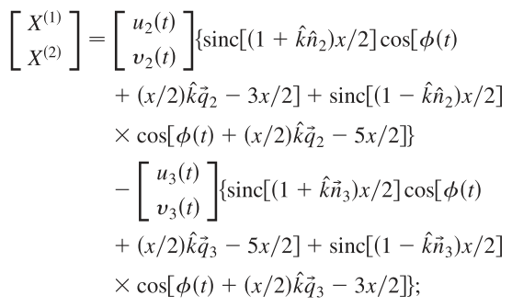
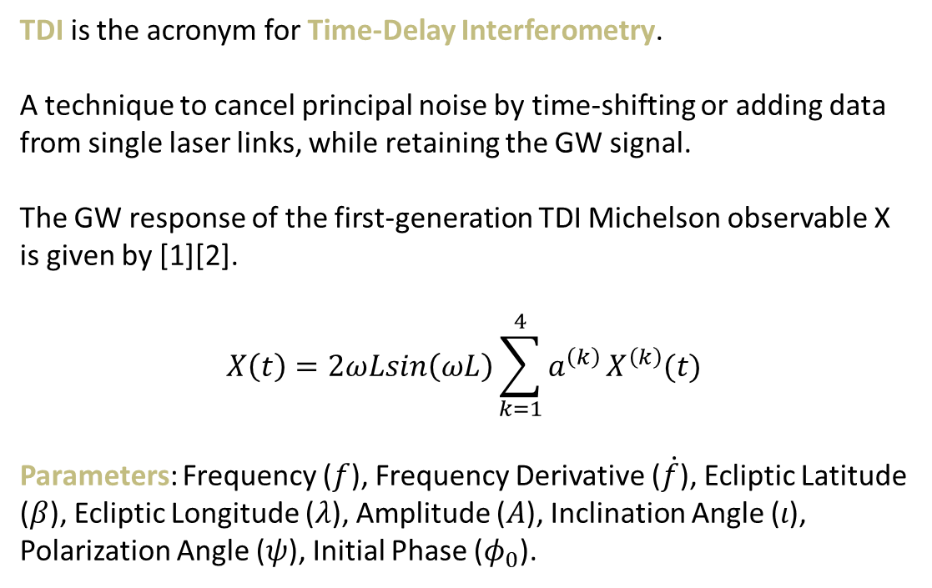
TDI responses
TDI is the acronym for Time-Delay Interferometry.
A technique to cancel principal noise by time-shifting or adding data from single laser links, while retaining the GW signal.
The GW response of the first-generation TDI Michelson observable X is given by [1][2].
$$X\left(t\right)=2ωLsin\left(ωL\right)\sum_{k=1}^{4}{a^{\left(k\right)}}X^{\left(k\right)}(t)$$
Parameters: Frequency ($f$), Frequency Derivative ($\dot{f}$), Ecliptic Latitude ($β$), Ecliptic Longitude ($λ$), Amplitude ($A$), Inclination Angle ($ι$), Polarization Angle ($ψ$), Initial Phase ($φ_{0}$).
[1]. A. Kro´lak, M. Tinto, and M. Vallisneri, Phys. Rev. D 70, 022003 (2004); 76, 069901(E) (2007).
[2]. A. Błaut, S. Babak, and A. Królak, Phys. Rev. D 81, 063008 (2010).

Slide 15
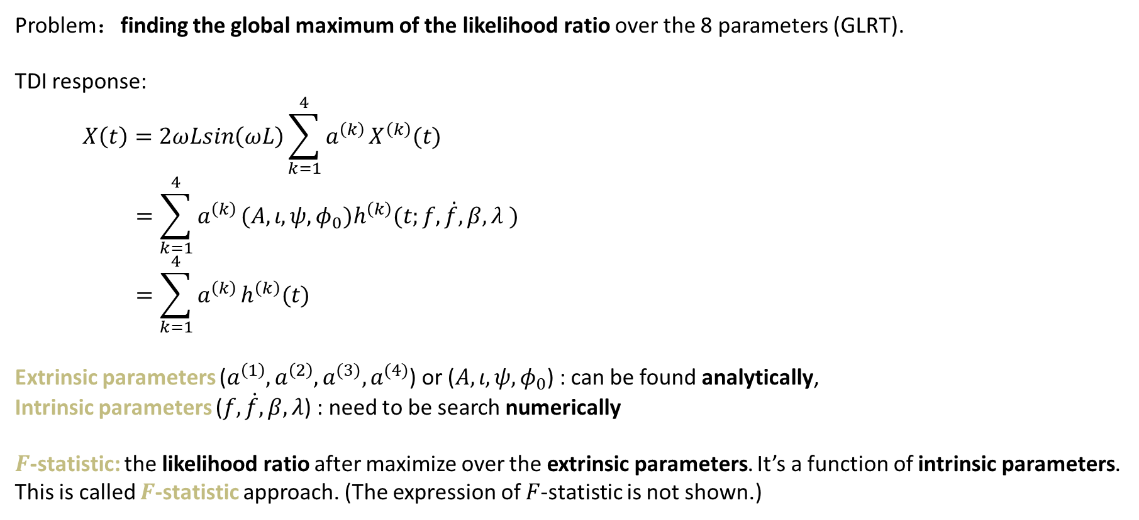
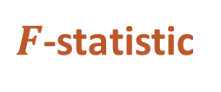
$F$-statistic
Problem：finding the global maximum of the likelihood ratio over the 8 parameters (GLRT).
TDI response:
$$X\left(t\right)=2ωLsin\left(ωL\right)\sum_{k=1}^{4}{a^{\left(k\right)}}X^{\left(k\right)}(t)$$
$$=\sum_{k=1}^{4}{a^{\left(k\right)}}(A,ι,ψ,φ_{0})h^{\left(k\right)}(t;f,\dot{f},β,λ )$$
$$=\sum_{k=1}^{4}{a^{\left(k\right)}}h^{\left(k\right)}(t)$$
Extrinsic parameters ($a^{\left(1\right)},a^{\left(2\right)}, a^{(3)}, a^{(4)}$) or ($A,ι,ψ,φ_{0}$) : can be found analytically,
Intrinsic parameters ($f, \dot{f}, β, λ$) : need to be search numerically
$F$-statistic: the likelihood ratio after maximize over the extrinsic parameters. It’s a function of intrinsic parameters. This is called $F$-statistic approach. (The expression of $F$-statistic is not shown.)

Slide 16
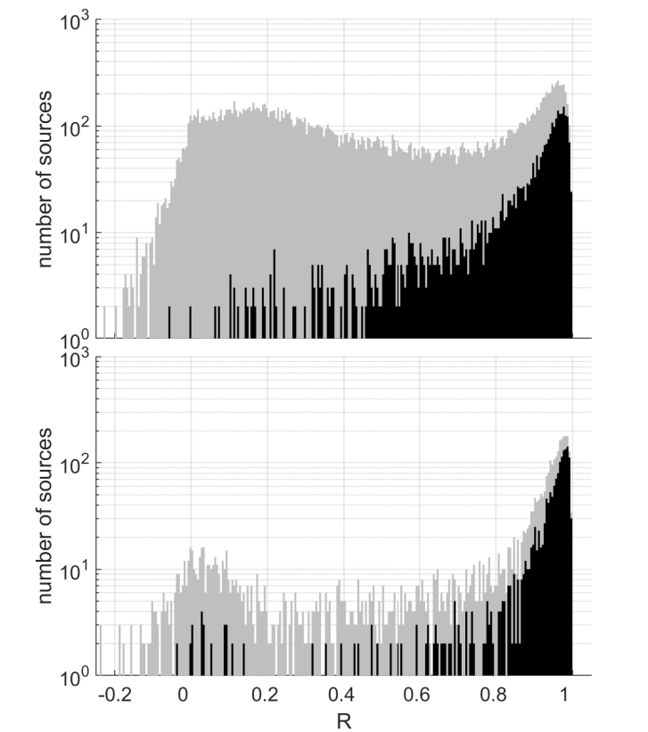
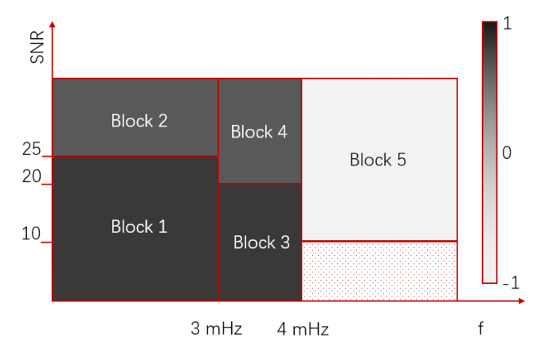
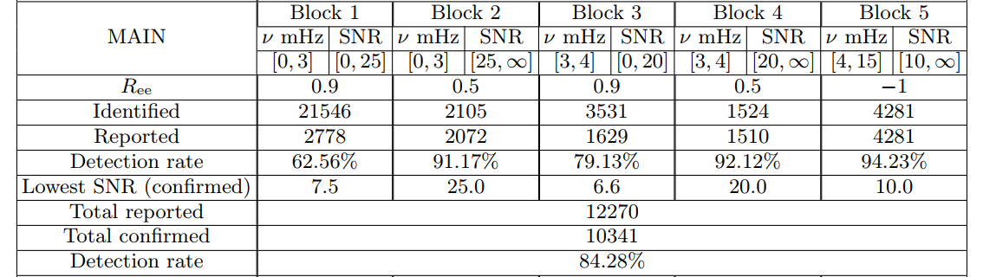

Cross-validation
Basic idea:
Run two independent search but with different $\dot{f}$ search range for PSO.
Keep only estimated sources that are recovered in both searches.
We split the sources into different blocks, and applied different cutoff parameters ($R_{ee}$).
In this way, we eliminated a lot of spurious sources, especially for f<4mHz, and low SNR sources.

Slide 17
Future improvements
采用更准确的 TDI 响应公式，如考虑臂长不等且随时间变化的 TDI 响应模型
考虑实际噪声不一定可以假设高斯，稳态等性质，噪声功率谱密度也未知
实际数据中不只有双白矮星信号，需探讨不同类型波源存在时对搜索的影响
低频部分仍有大量高度混叠的双白矮星波源，如何搜索是重点

Slide 18
THANKS

Slide 20
Future improvements:
TDI response, more realistic TDI model
Noise unknown, more realistic noise model
Other types of sources present in the data
Try to resolve low frequency confusion noise

Slide 21
For comparison
LDC1-4
Detection rate：84.29% ~ 91.19%
Reported: 12270 ~ 9291
Confirmed: 10342 ~ 8472
A. Blaut, S. Babak, and A. Krolak, 2010. MLDC3, ~12000 confirmed, different metric
N. J. Cornish and J. Crowder, 2007. MLDC2
(MTJPL, BAM) MCMC, from MLDC 2 report, ~85%, ~20000 reported, (code is lost)
Littenberg, 2010. MLDC4
MCMC ~90%, ~9000 reported

